Slide 1


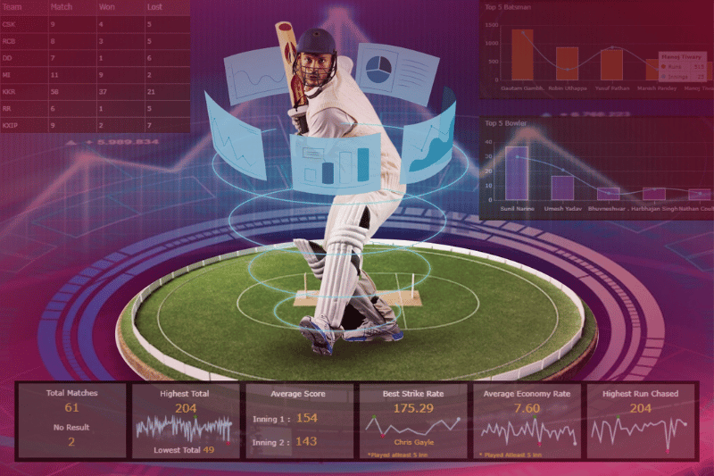
WELCOME
INTRODUCTION
COMPREHENSIVE ANALYIS OF IPL SEASONS 2021-2023 USING SQL
Dubai
Canada
Japan
Indonesia
BY,
GOWTHAM S
About country here
About country here
About country here
About country here
SQL

Slide 2

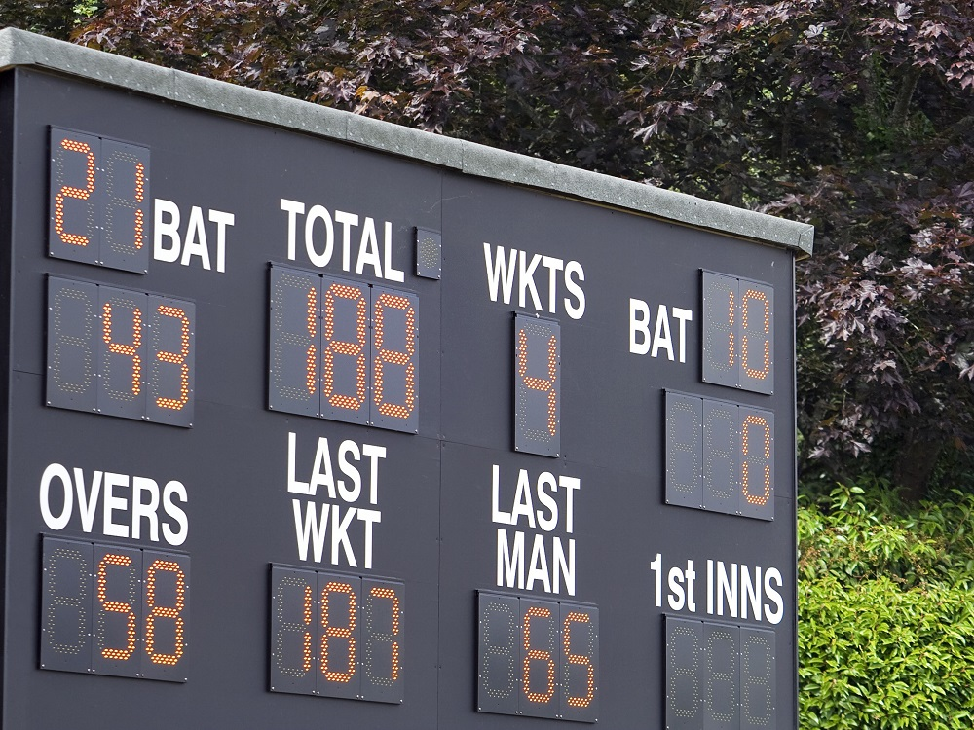
WHAT IS SQL?
SQL, or Structured Query Language, is a programming language used to communicate with databases.
Store Data
Retrieve Data
Update Data
Delete Data
Canada
Japan
Indonesia
Malaysia
About country here
About country here
About country here
About country here
SQL
SQL
Structured Query Language

Slide 3
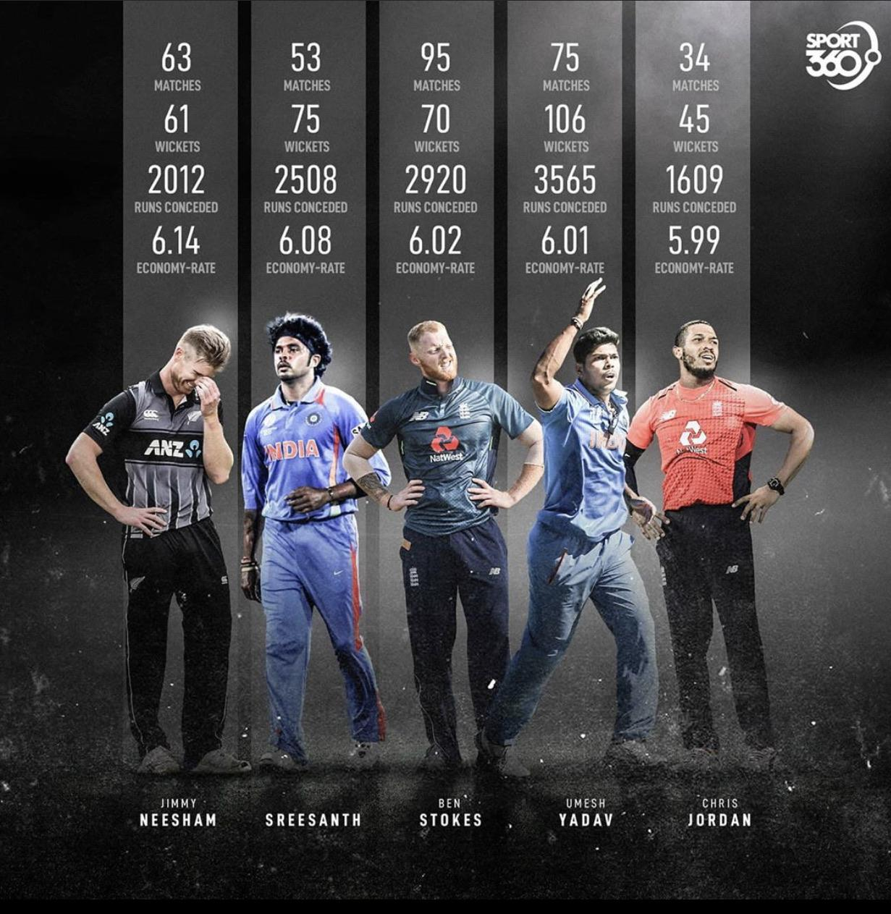
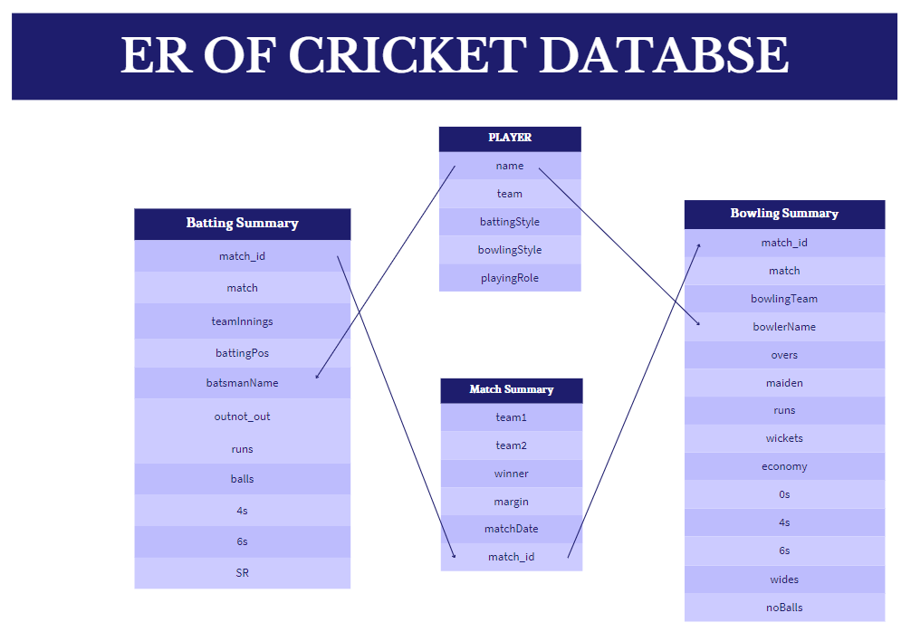
CRICKET DATABASE
1.Batting Summary Database
2.Bowling Summary Database
3.Match Summary Database
Canada
Japan
Indonesia
Malaysia
About country here
About country here
About country here
About country here
DATABASE
SQL
Structured Query Language

Slide 4
CRICKET DATABASE
1.Batting Summary Database
2.Bowling Summary Database
3.Match Summary Database
Canada
Japan
Indonesia
Malaysia
About country here
About country here
About country here
About country here
Country
SQL
Structured Query Language

Slide 5

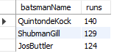
CHALLENGES:
1. Scores in a Match
List the top 3 highest-scoring batsmen for a given match along with their runs.
USING BATSMEN DATABASE
USE batting_summary;
SELECT batsmanName,runs
FROM mytable
ORDER BY runs DESC
LIMIT 3;
Japan
Indonesia
Malaysia
Dubai
About country here
About country here
About country here
About country here
Top Scored
OUTPUT

Slide 6
CHALLENGES:
TOP 3 SCORES
Japan
Indonesia
Malaysia
Dubai
About country here
About country here
About country here
About country here
Top Scored
OUTPUT

Slide 7
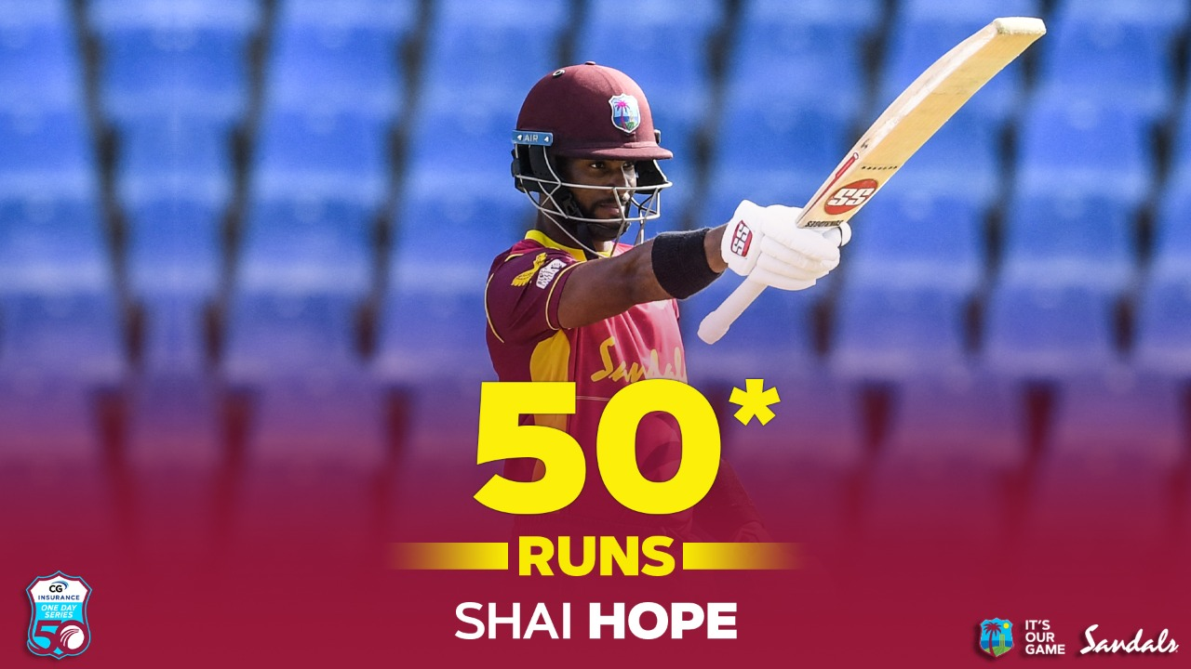
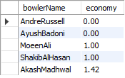
CHALLENGES:
2. Best Economy Rates
Find the top 5 bowlers with the best economy rates in a given season.
USING BOWLING DATABASE
USE bowling_summary;
SELECT bowlerName,economy
FROM mytable
ORDER BY economy ASC
LIMIT 5;
Japan
Indonesia
Malaysia
Dubai
About country here
About country here
About country here
About country here
ECONOMY
OUTPUT

Slide 8
CHALLENGES:
TOP 5 ECONOMY SCORES
Japan
Indonesia
Malaysia
Dubai
About country here
About country here
About country here
About country here
ECONOMY
OUTPUT

Slide 9
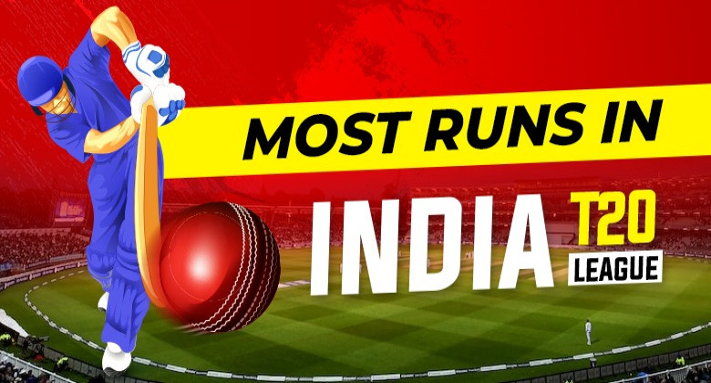
CHALLENGES:
3. Most Sixes in a Match
Identify the batsman who hit the most sixes in a particular match
USING BATTING DATABASE
USE batting_summary;
SELECT matchh_id,matchh,batsmanName,6s
FROM mytable
ORDER BY 6s DESC
LIMIT 1;
Japan
Indonesia
Malaysia
Dubai
About country here
About country here
About country here
About country here
MOST 6s
OUTPUT

Slide 10
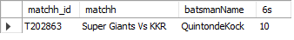
CHALLENGES:
TOP 6S IN A MATCH
Japan
Indonesia
Malaysia
Dubai
About country here
About country here
About country here
About country here
MOST 6s
OUTPUT

Slide 11
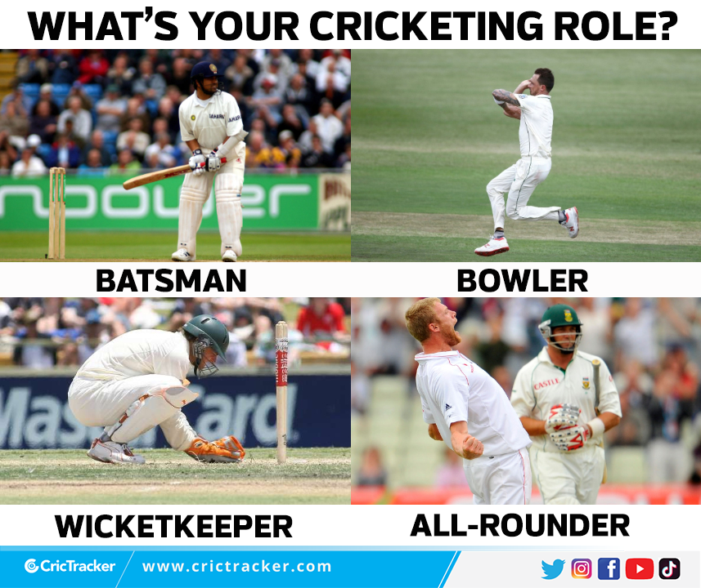
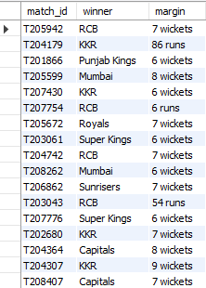
CHALLENGES:
4. Match Winners by Margin
List all matches where the winning team won by a margin of more than 50 runs or 6 wickets.
USING MATCH SUMMARY DATABASE
USE match_summary;
SELECT match_id,winner,margin
FROM mytable
WHERE margin > "50 runs" OR margin >"6 wickets";
Japan
Indonesia
Malaysia
Dubai
About country here
About country here
About country here
About country here
Top Margin
OUTPUT

Slide 12
CHALLENGES:
TOP MARGIN IN A MATCH
Japan
Indonesia
Malaysia
Dubai
About country here
About country here
About country here
About country here
Top Margin
OUTPUT

Slide 13

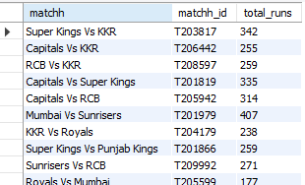
CHALLENGES:
5. Team's Total Runs in a Match
Calculate the total runs scored by each team in a specific match.
USING BATTING DATABASE
USE batting_summary;
SELECT matchh,matchh_id,sum(runs) as total_runs FROM mytable ;
GROUP BY matchh_id,matchh;
Japan
Indonesia
Malaysia
Dubai
About country here
About country here
About country here
About country here
HIGHEST RUNS
OUTPUT

Slide 14
CHALLENGES:
HIGHEST RUNS IN A MATCH
Japan
Indonesia
Malaysia
Dubai
About country here
About country here
About country here
About country here
HIGHEST RUNS
OUTPUT

Slide 15
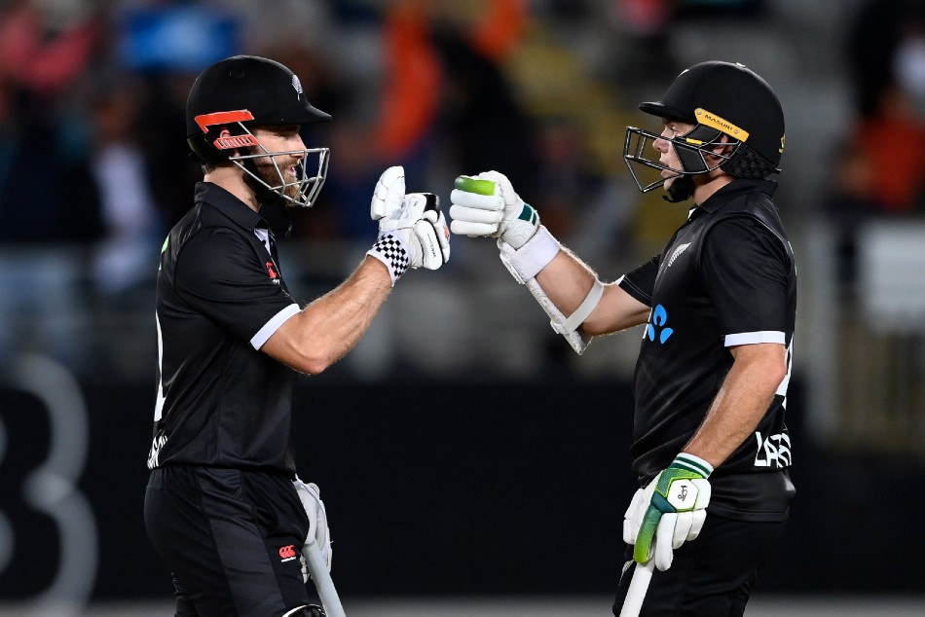
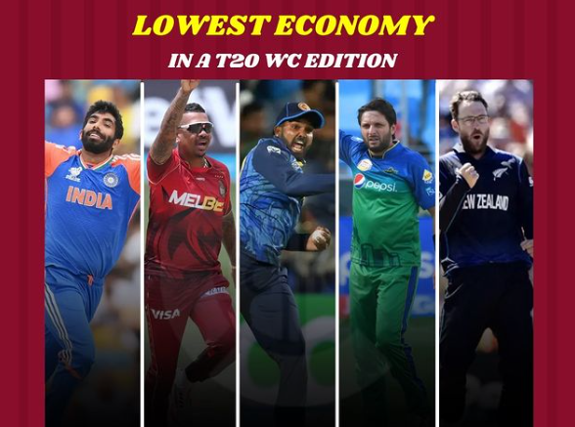
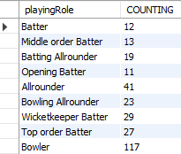
CHALLENGES:
6. Players' Roles Distribution
Count the number of players in each playing role (batsman, bowler, all-rounder, etc.) in the tournament.
USING PLAYER DATABASE
USE PLAYER;
SELECT playingRole,count(playingRole) AS COUNTING FROM mytable
GROUP BY playingRole;
Japan
Indonesia
Malaysia
Dubai
About country here
About country here
About country here
About country here
PLAYERS ROLE’S
OUTPUT

Slide 16
CHALLENGES:
COUNT OF PLAYER’S ROLE
Japan
Indonesia
Malaysia
Dubai
About country here
About country here
About country here
About country here
PLAYERS ROLE’S
OUTPUT

Slide 17
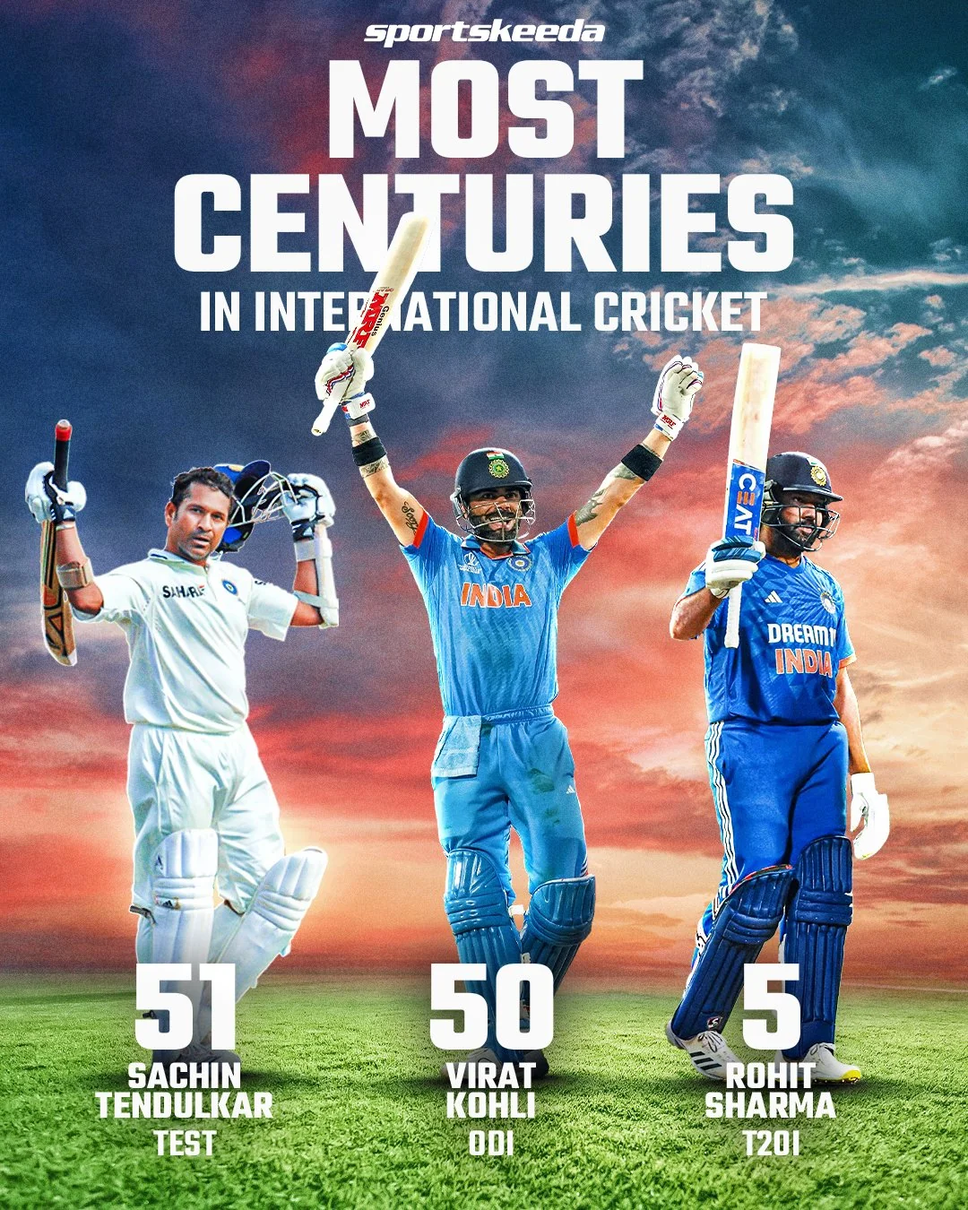
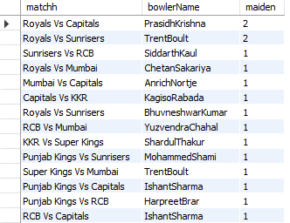
CHALLENGES:
7. Maiden Overs by Bowlers
List the bowlers who have bowled maiden overs in a specific match and how many they bowled.
USING BOWLING SUMMARY DATABASE
USE player;
SELECT matchh,bowlerName,count(*) as maiden
FROM mytable WHERE maiden >= 1
GROUP BY matchh,bowlerName;
Japan
Indonesia
Malaysia
Dubai
About country here
About country here
About country here
About country here
LOW SCORE
OUTPUT

Slide 18
CHALLENGES:
TOP MAIDEN PLAYER
Japan
Indonesia
Malaysia
Dubai
About country here
About country here
About country here
About country here
LOW SCORE
OUTPUT

Slide 19
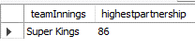
CHALLENGES:
8. Top Partnerships
Determine the highest batting partnership for a particular team in a specific match.
USING BATTING SUMMARY DATABASE
USE batting_summary;
SELECT * FROM mytable;
SELECT teamInnings, MAX(partnership) AS highestpartnership
FROM (SELECT matchh_id,teamInnings, SUM(runs) AS partnership FROM mytable WHERE matchh_id="T203817" AND teamInnings="Super Kings“
GROUP BY matchh_id,teamInnings,battingPos) AS subquery
GROUP BY teamInnings;
Japan
Indonesia
Malaysia
Dubai
About country here
About country here
About country here
About country here
BATTING PARTNERSHIP
OUTPUT

Slide 20
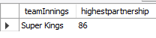
CHALLENGES:
HIGHEST BATTING PARTNERSHIP
Japan
Indonesia
Malaysia
Dubai
About country here
About country here
About country here
About country here
BATTING PARTNERSHIP
OUTPUT

Slide 21
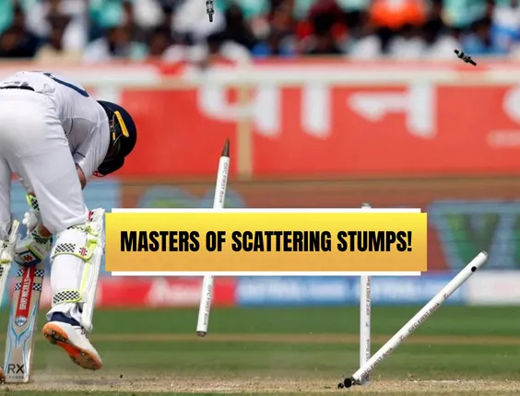
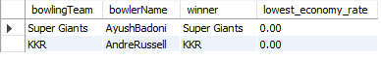
CHALLENGES:
9. Most Economical Bowler
Identify the bowler with the lowest economy rate in matches won by their team.
USING BOWLING,MATCHING SUMMARY DATABASE
USE bowling_summary;
USE match_summary;
SELECT b.bowlingTeam, b.bowlerName,m.winner, MIN(b.economy) AS lowest_economy_rate
FROM bowling_summary.mytable b
JOIN match_summary.mytable m
ON b.matchh_id = m.match_id
WHERE b.bowlingTeam = m.winner
GROUP BY b.bowlerName, b.bowlingTeam,m.winner
ORDER BY lowest_economy_rate ASC
LIMIT 1;
Japan
Indonesia
Malaysia
Dubai
About country here
About country here
About country here
About country here
LOWEST ECONOMY
OUTPUT

Slide 22

CHALLENGES:
MOST ECONOMIC BOWLER
Japan
Indonesia
Malaysia
Dubai
About country here
About country here
About country here
About country here
LOWEST ECONOMY
OUTPUT

Slide 23

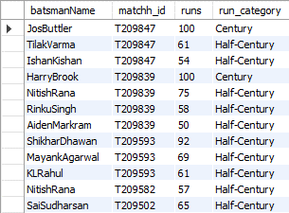
CHALLENGES:
10.Centuries and Half-Centuries
List all the batsmen who have scored centuries (100 or more runs) or half-centuries (50-99 runs) in a match.
USING BATTING SUMMARY DATABASE
USE batting_summary;
SELECT batsmanName,matchh_id,runs,
CASE
WHEN runs>=100 THEN "Century“
WHEN runs>=50 AND runs < 100
THEN "Half-Century"ELSE "Dummy“
END as run_category
FROM mytablewhere runs>=50
ORDER BY runs desc;
Japan
Indonesia
Malaysia
Dubai
About country here
About country here
About country here
About country here
MOST CENTURIES
OUTPUT

Slide 24
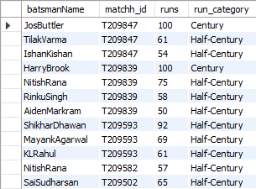
CHALLENGES:
CENTURY AND HALF CENTURY
Japan
Indonesia
Malaysia
Dubai
About country here
About country here
About country here
About country here
MOST CENTURIES
OUTPUT

Slide 25

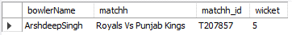
CHALLENGES:
11.Most Dismissals by a Bowler
Find the bowler with the highest number of dismissals (wickets taken) in a particular match.
USING BOWLING SUMMARY DATABASE
USE bowling_summary;
SELECT bowlerName,matchh,matchh_id,sum(wickets)
AS wicket
FROM mytable
GROUP BY matchh_id,bowlerName,match
ORDER BY wicket DESC
LIMIT 1;
Japan
Indonesia
Malaysia
Dubai
About country here
About country here
About country here
About country here
MOST DISMISSAL
OUTPUT

Slide 26
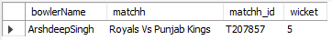
CHALLENGES:
MOST DISMISSAL BY BOWLER
Japan
Indonesia
Malaysia
Dubai
About country here
About country here
About country here
About country here
MOST DISMISSAL
OUTPUT

Slide 27

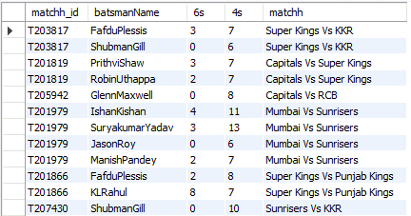
CHALLENGES:
12.Boundary Hitters
List the batsmen who have hit more than 5 boundaries (fours and sixes) in a match.
USING BATTING SUMMARY DATABASE
USE batting_summary;
SELECT matchh_id,batsmanName,6s,4s,matchh
FROM mytable
WHERE 6s > 5 or 4s > 5
GROUP BY matchh_id,batsmanName,4s,6s,matchh
Japan
Indonesia
Malaysia
Dubai
About country here
About country here
About country here
About country here
BOUNDARY
OUTPUT

Slide 28
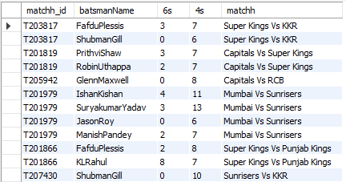
CHALLENGES:
BOUNDARY HITTERS
Japan
Indonesia
Malaysia
Dubai
About country here
About country here
About country here
About country here
BOUNDARY
OUTPUT

Slide 29
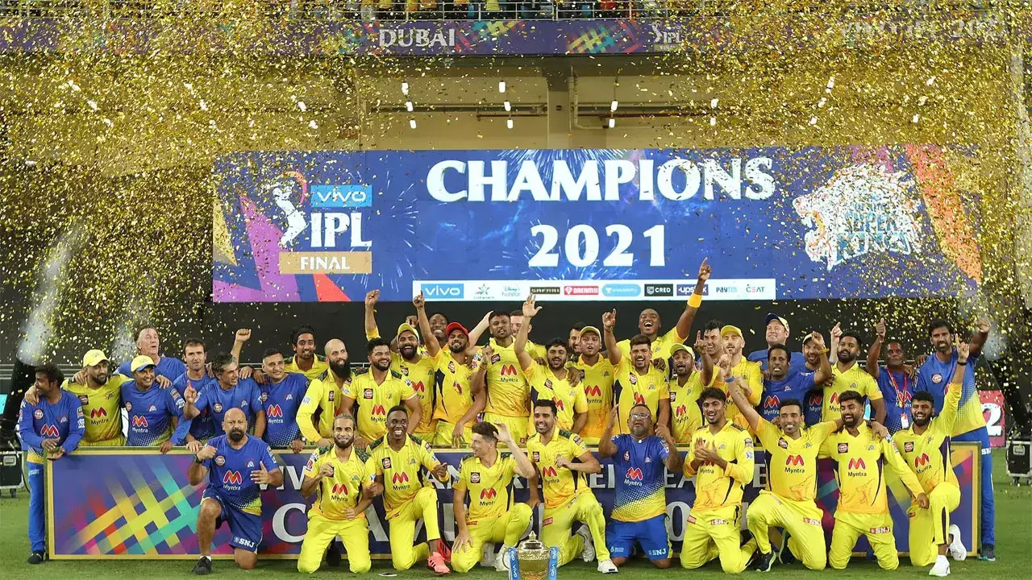
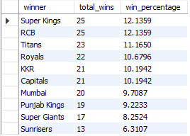
CHALLENGES:
13.Win Percentage of Teams
Calculate the win percentage of each team across the tournament.
USING MATCH SUMMARY DATABASE
USE match_summary;
SELECT m.winner,COUNT(m.winner)
AS total_wins,(COUNT(m.winner) / (SELECT COUNT(*)
FROM match_summary.mytable)) * 100
AS win_percentage
FROM match_summary.mytable m
GROUP BY m.winner
ORDER BY win_percentage DESC;
Japan
Indonesia
Malaysia
Dubai
About country here
About country here
About country here
About country here
WIN PERCENT
OUTPUT

Slide 30

CHALLENGES:
WIN PERCENTAGE
Japan
Indonesia
Malaysia
Dubai
About country here
About country here
About country here
About country here
WIN PERCENT
OUTPUT

Slide 31

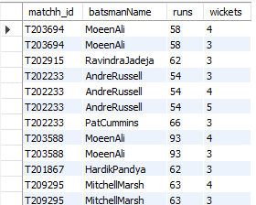
CHALLENGES:
14.All-round Performers
Identify players who have scored more than 50 runs and taken 3 or more wickets in a match.
USING BATTING,BOWLI NG SUMMARY DATABASE
USE batting_summary;
USE bowling_summary;
SELECT DISTINCT b.matchh_id,b.batsmanName,
b.runs,bw.wickets;
FROM batting_summary.mytable b
JOIN bowling_summary.mytable bw
ON b.batsmanName = bw.bowlerName
WHERE b.runs>50 AND bw.wickets>=3
Japan
Indonesia
Malaysia
Dubai
About country here
About country here
About country here
About country here
ALL ROUNDER
OUTPUT

Slide 32
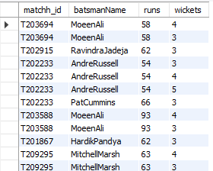
CHALLENGES:
ALL ROUND PERFORMERS
Japan
Indonesia
Malaysia
Dubai
About country here
About country here
About country here
About country here
ALL ROUNDER
OUTPUT

Slide 33

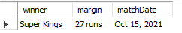
CHALLENGES:
15.Match Results by Date
List all matches with their results (winner, margin) that were played on a specific date.
USING MATCH SUMMARY DATABASE
USE match_summary;
SELECT m.winner,m.margin,m.matchDate
FROM mytable m
WHERE m.matchDate="Oct 15, 2021"
Japan
Indonesia
Malaysia
Dubai
About country here
About country here
About country here
About country here
RESULT
OUTPUT

Slide 34
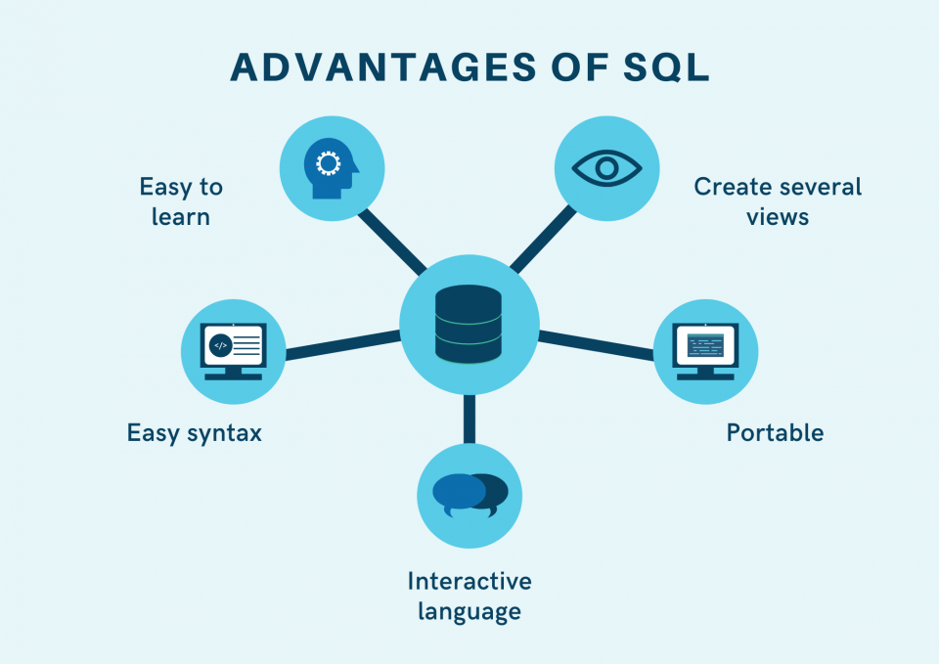
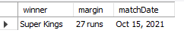
CHALLENGES:
MATCH RESULT BY DATE
Japan
Indonesia
Malaysia
Dubai
About country here
About country here
About country here
About country here
RESULT
OUTPUT

Slide 35

ADVANTAGES
Canada
About country here
ADVANTAGES
SQL

Slide 36
THANK YOU
Canada
Japan
About country here
About country here

